Slide 1

Black Friday sales prediction

Slide 2
conteNts
INTRODUCTION
PROBLEM STATEMENT
DATA COLLECTION
PREPROCESSING
DATA MODELLING
DEPLOYMENT
USER INTERFACE CREATION
CONCLUSION

Slide 3
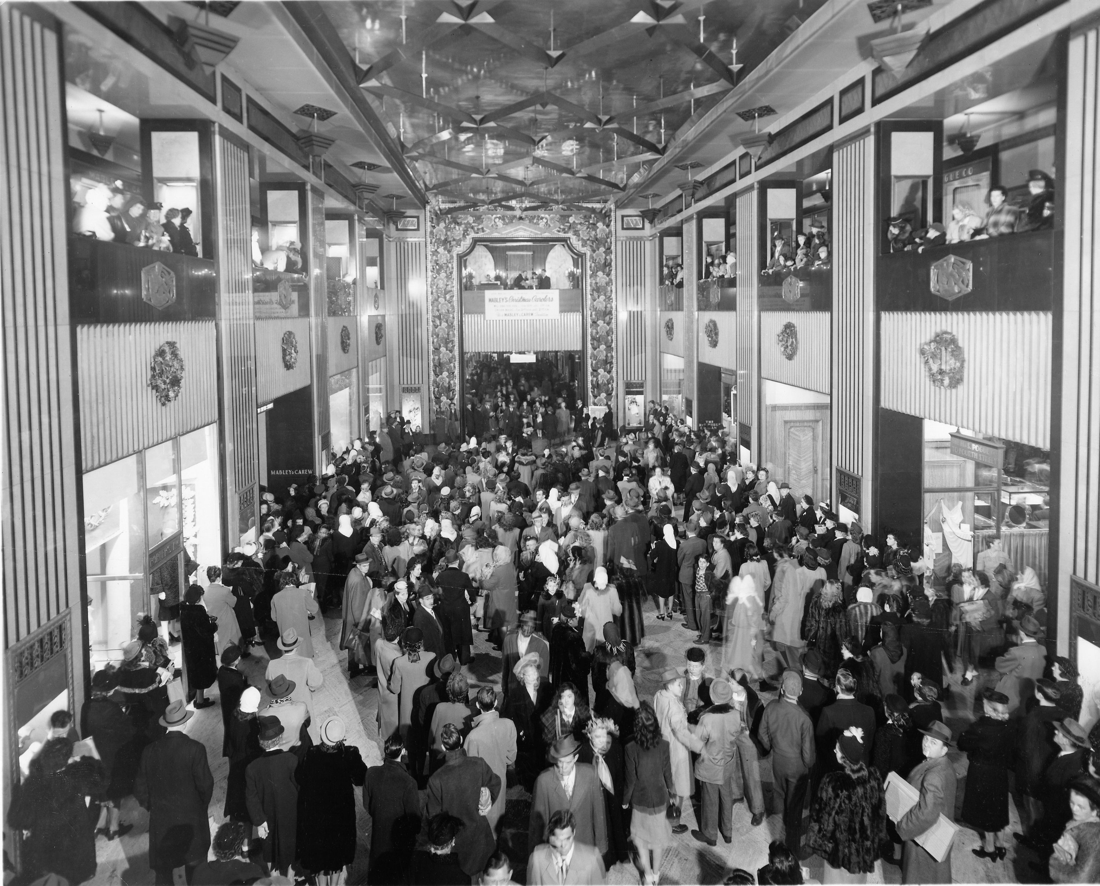
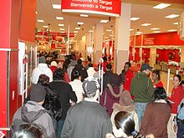
introduction
Black Friday Is a shopping day for a combination of reasons. As the first day after the last major holiday before christmas, it marks the unofficial beginning of the christmas shopping season. Additionally, many employers give their employees the day off as part of the thanksgiving holiday weekend.

Slide 4
Problem statement
The challenge was to predict purchase prices of various products purchased by customers based on historical purchase patterns. The data contained features like age, gender, marital status, categories of products purchased, city demographics
etc.

Slide 5

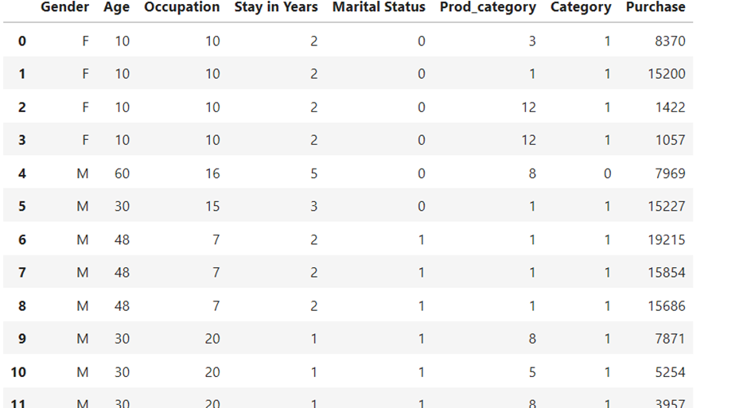
Data collection
Kaggle is the place to do data science projects

Slide 6
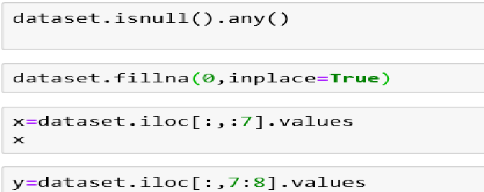
preprocessing

Slide 7
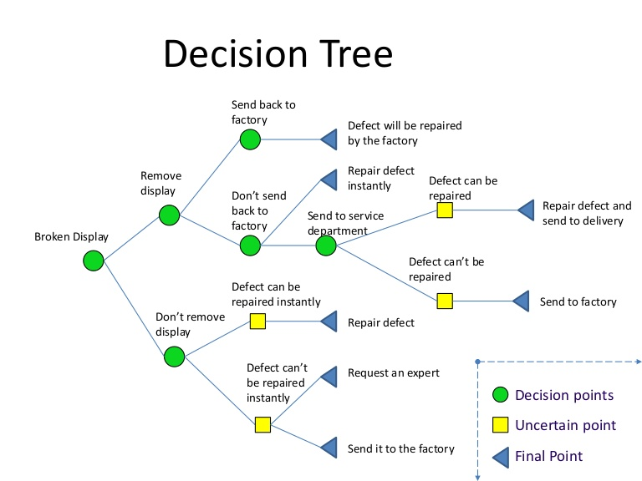
Data modelling

Slide 8
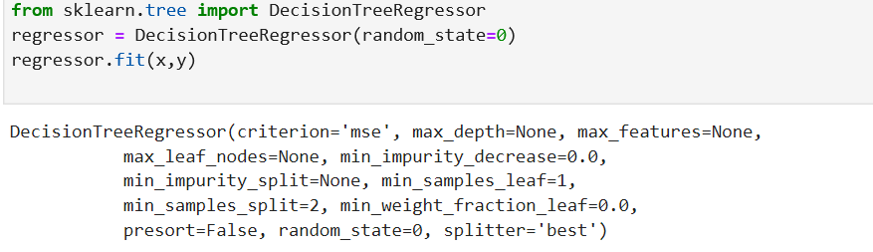
.

Slide 9
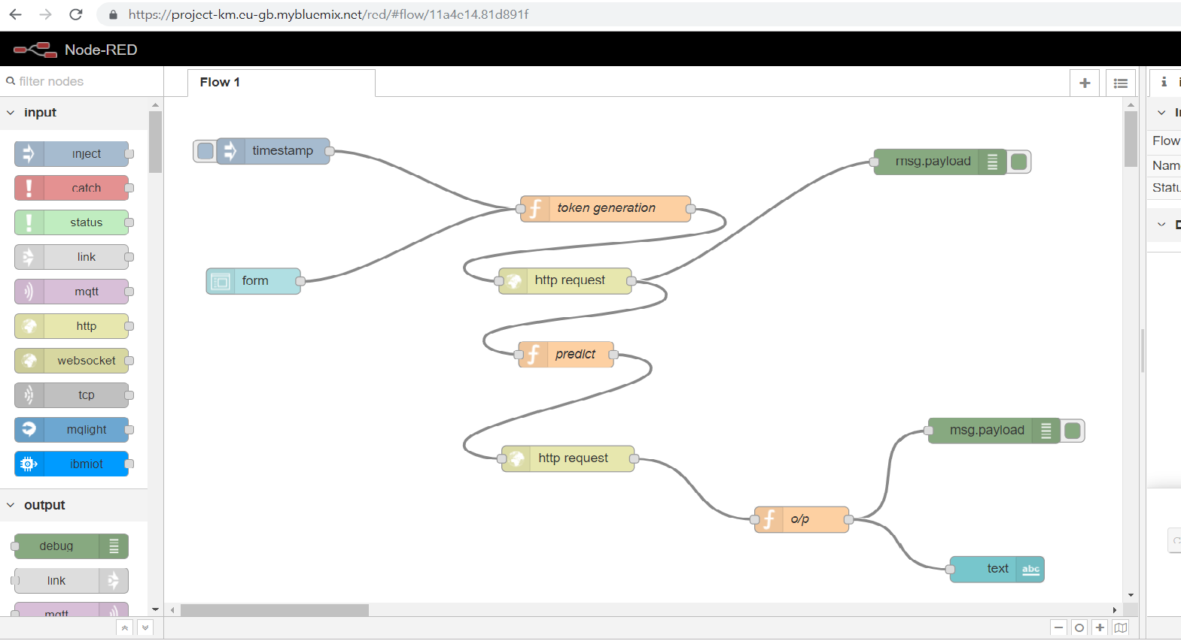
DEPLOYMENT

Slide 10
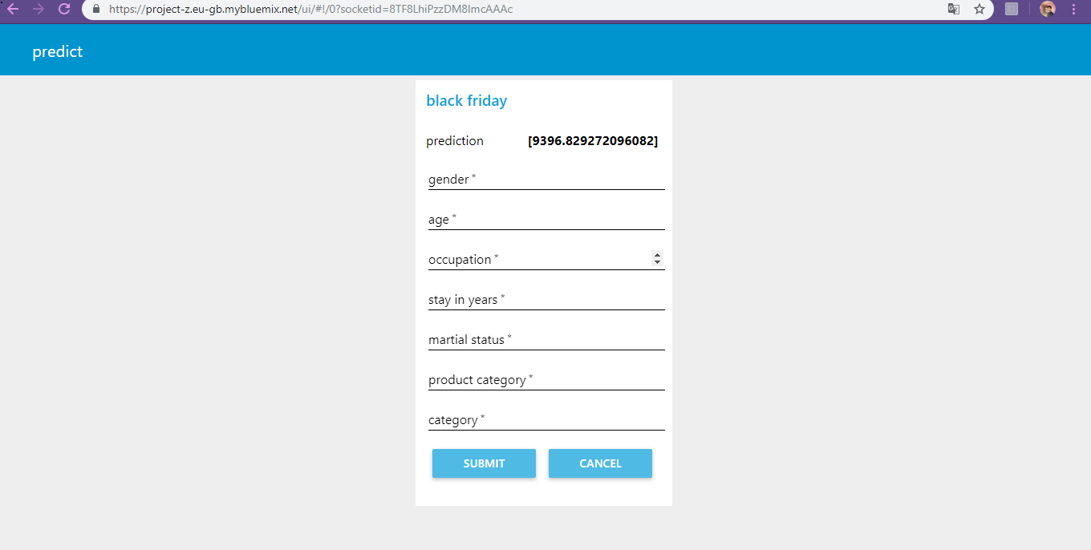
User interface creation

Slide 11
conclusion
Machine learning can be used for a variety of tasks. In this , we used a machine learning algorithm to predict the amount that a customer is likely to spend on black friday. We also performed exploratory data analysis to find interesting trends from the dataset. For the sake of practice, I will suggest that you try to predict the product that the customer is more likely to purchase, depending upon his gender, age, and occupation.

Slide 12
Thank you!!

